Slide 1
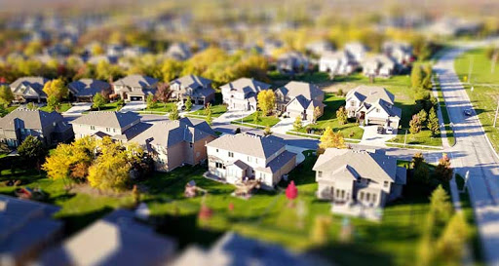
Sustainable Cities
City Planning
LO. I can work collaboratively to generate a plan of my sustainable city.

Slide 2
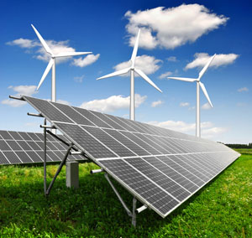
Energy
What have you used today that requires energy?
People have come to expect higher standards of living and the latest devices use up valuable energy.
Even today we use a lot of fossil fuels, like oil coal and gas. In the past 200 years we have used over two thirds of the world’s resources already. Is renewable energy our future?
How will your city be powered??

Slide 3
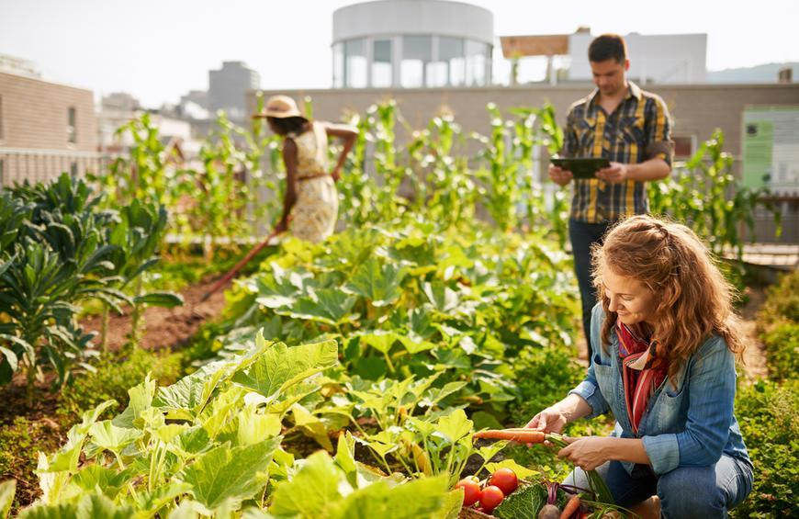
Food
What have you eaten today? Where did that food come from?
The more people there are the more food we need, but where will it all come from? Transporting food from far away is expensive and pollutes the environment. We also waste a lot of food; in the UK alone about 30 % of all food gets thrown in the bin!
How will you grow enough food, and make sure as little gets thrown away as possible?

Slide 4
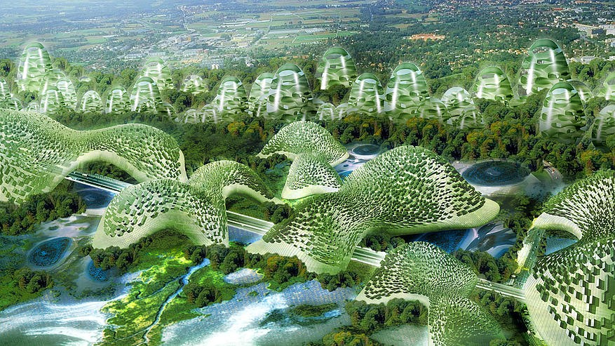
Nature
Humans are not the only living things in order for our survival we need to make sure our plants and animals can prosper. Green areas in your city are important not just for humans but you will need to help wildlife move around your city on ‘wildlife corridors’. Wildlife Corridors are areas of planting that help the green areas in your city link up for wildlife. It may be some plants on the edge of a road, or even people’s gardens. It won’t be just vegetables you will need to grow, flowers provide valuable nectar for pollinators which will in turn increase your food crop. It has also been proven that if people can see nature every day, and not just buildings, they are much happier and healthier.
Try and think of why you might need different plants and animals, this will help you make sure you have it in your city. How will you make sure nature is encouraged into your city?

Slide 5
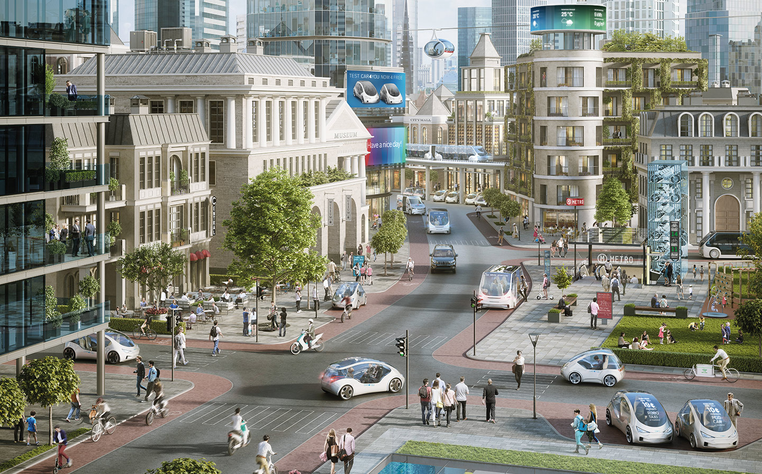
Transport
The way your population moves around the city is crucial for city living. Singapore aimed to ensure 80% of its population lived within a 10 minute walk of a train station. This needs to be carefully designed. Cars, buses, trains and trams, boats on rivers as well as walkways for pedestrians and lanes for cyclists will all play a part. Some of the largest cities in the world have even moved their transport out of the way using underground trains and elevated monorail systems e.g. Las Vegas has motorways underneath it’s buildings.
Try to think of new ways that you could help with the infrastructure in your city. In many cities around the world the streets can become as famous as some of the buildings
What will transport look like in your city?

Slide 6
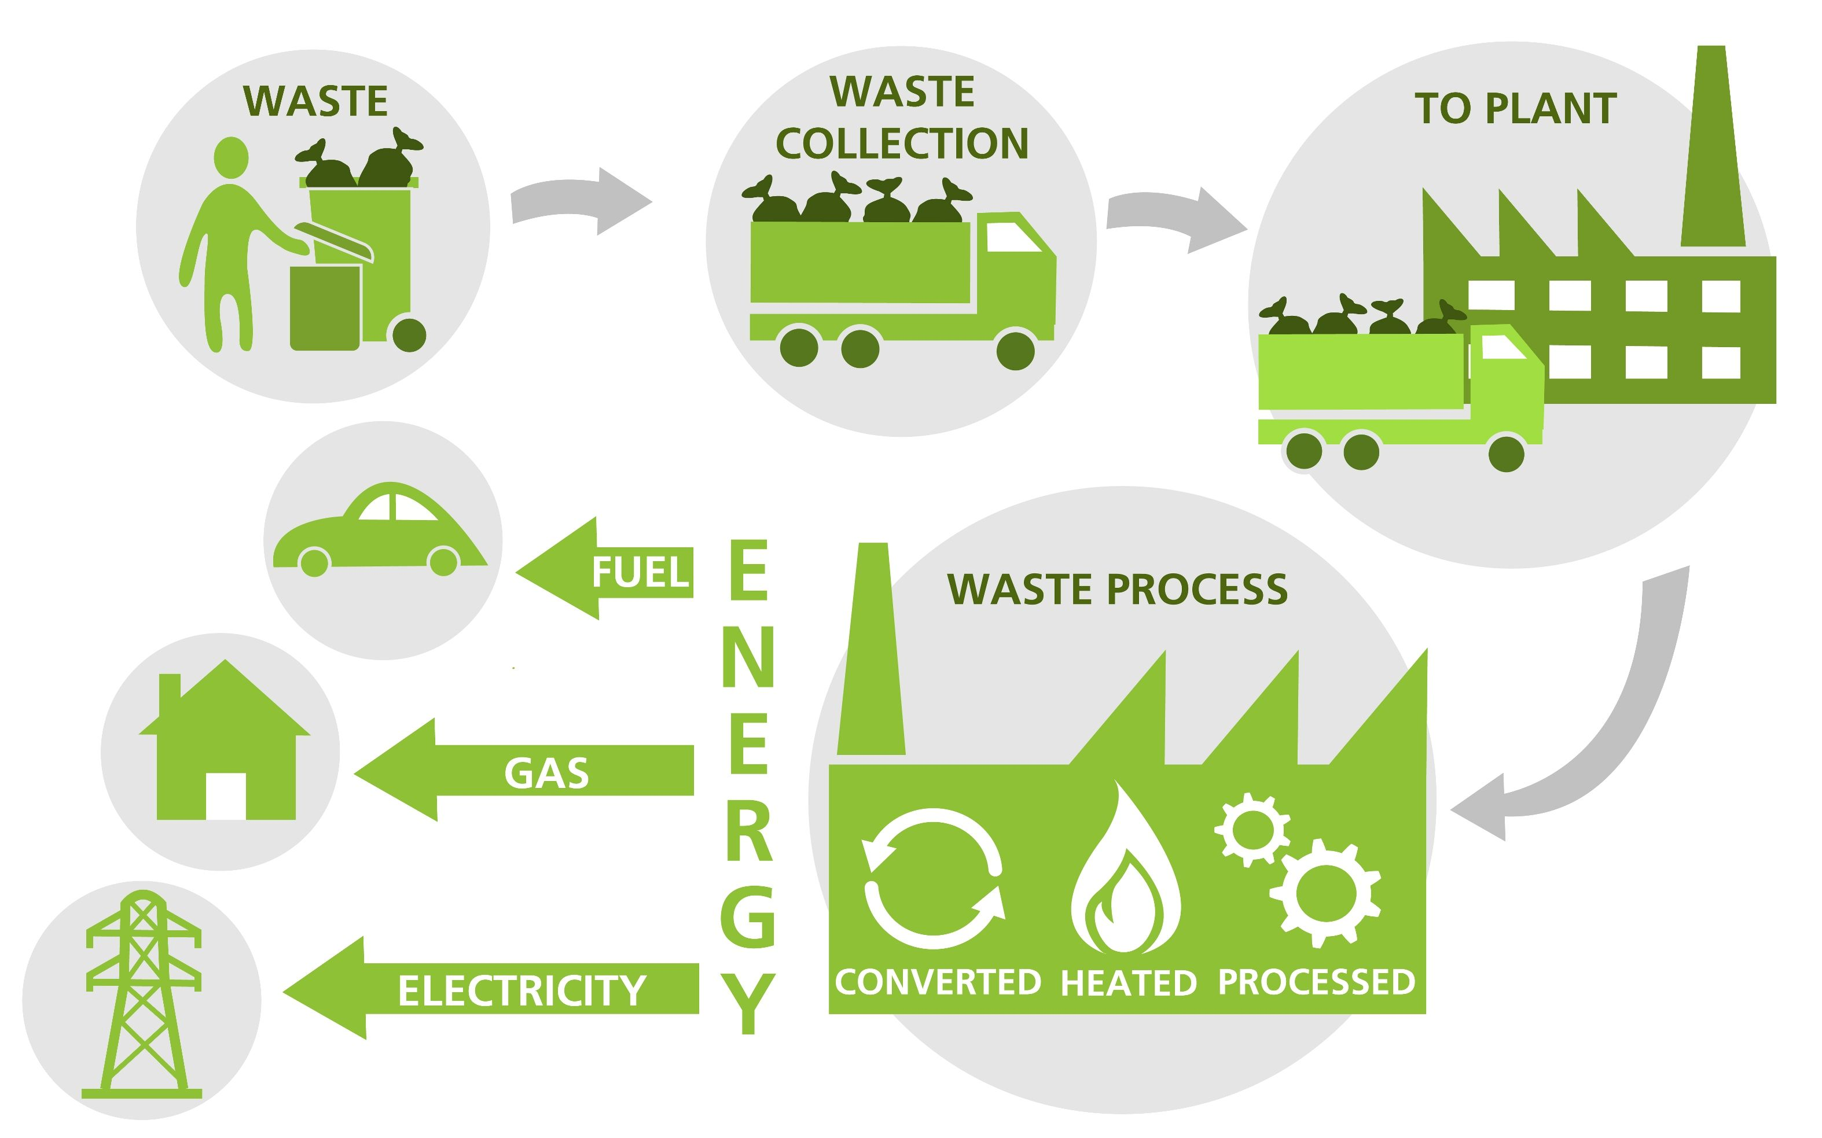
Waste
Shockingly, as a planet over 2 billion tonnes of waste is thrown away every year. The trouble is rubbish doesn’t always just rot away and finding somewhere to put all is becoming more of an increasingly serious problem. By not recycling we actually waste more energy. It takes a lot more energy to make a drinks can made from aluminium than it does to recycle and old can.
How will you encourage your city dwellers to recycle? How will they reduce their waste?

Slide 7
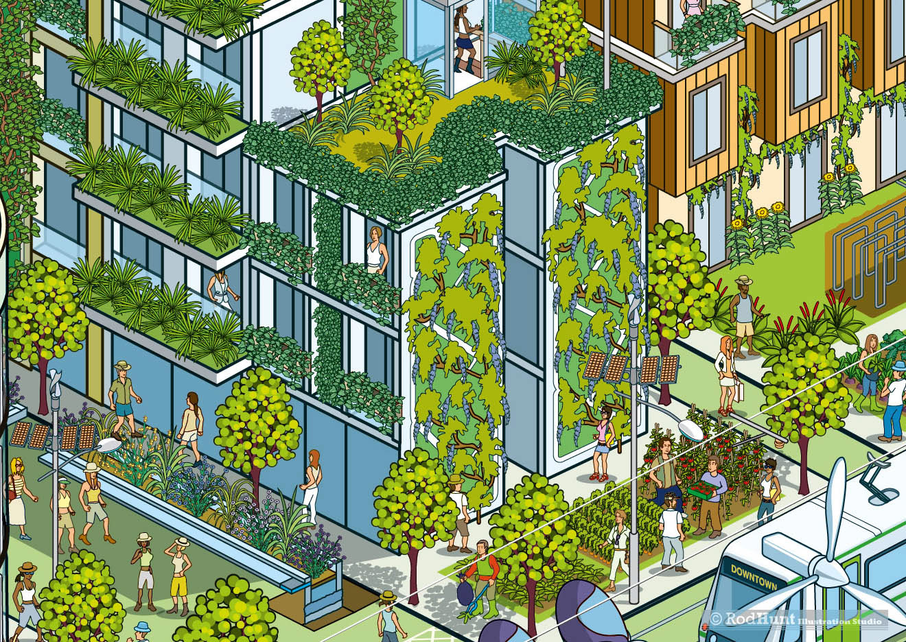
Now you are armed with the information and the right questions it’s your turn…
Your task for today is to design a 2-D plan – decide what you need to include in your sustainable city, and what the inhabitants of your city need to live there.
This will lead onto a 3-D design of your city.

